Slide 1
THE LIFE OF CHRIST
PART 50

Slide 2
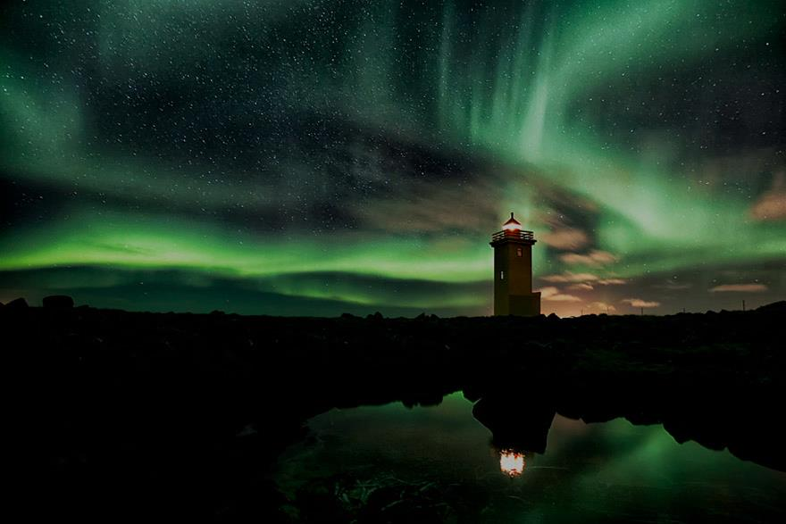
Matthew 18:15 " Moreover if your brother sins against you, go and tell him his fault between you and him alone. If he hears you, you have gained your brother. ¹⁶ "But if he will not hear, take with you one or two more, that 'by the mouth of two or three witnesses every word may be established.' ¹⁷ "And if he refuses to hear them, tell it to the church. But if he refuses even to hear the church, let him be to you like a heathen and a tax collector.

Slide 3
1. If your brother sins against you, you have a responsibility to go tell him what he has done to you, so that he can see that he has sinned against you.

Slide 4
James 5:19 Brethren, if anyone among you wanders from the truth, and someone turns him back, ²⁰ let him know that he who turns a sinner from the error of his way will save a soul from death and cover a multitude of sins.

Slide 5
2. ¹⁶ "But if he will not hear, take with you one or two more, that 'by the mouth of two or three witnesses every word may be established.'

Slide 6
3. ¹⁷ "And if he refuses to hear them, tell it to the church. But if he refuses even to hear the church, let him be to you like a heathen and a tax collector.

Slide 7
2 Thessalonians 3:6 But we command you, brethren, in the name of our Lord Jesus Christ, that you withdraw from every brother who walks disorderly and not according to the tradition which he received from us.
Romans 16:17 Now I urge you, brethren, note those who cause divisions and offenses, contrary to the doctrine which you learned, and avoid them.

Slide 8
1 Corinthians 5:11 But now I have written to you not to keep company with anyone named a brother, who is sexually immoral, or covetous, or an idolater, or a reviler, or a drunkard, or an extortioner -- not even to eat with such a person.
2 Thessalonians 3:14 And if anyone does not obey our word in this epistle, note that person and do not keep company with him, that he may be ashamed.

Slide 9
Matthew 18:18 "Assuredly, I say to you, whatever you bind on earth will be bound in heaven, and whatever you loose on earth will be loosed in heaven. ¹⁹ "Again I say to you that if two of you agree on earth concerning anything that they ask, it will be done for them by My Father in heaven. ²⁰ "For where two or three are gathered together in My name, I am there in the midst of them."

Slide 10
²⁰ "For where two or three are gathered together in My name, I am there in the midst of them."

Slide 11
Matthew 18:21 Then Peter came to Him and said, "Lord, how often shall my brother sin against me, and I forgive him? Up to seven times?" ²² Jesus said to him, "I do not say to you, up to seven times, but up to seventy times seven.

Slide 12
Luke 17:3 "Take heed to yourselves. If your brother sins against you, rebuke him; and if he repents, forgive him. ⁴ "And if he sins against you seven times in a day, and seven times in a day returns to you, saying, 'I repent,' you shall forgive him."

Slide 13
Matthew 18:23 "Therefore the kingdom of heaven is like a certain king who wanted to settle accounts with his servants. ²⁴ "And when he had begun to settle accounts, one was brought to him who owed him ten thousand talents. ²⁵ "But as he was not able to pay, his master commanded that he be sold, with his wife and children and all that he had, and that payment be made. ²⁶ "The servant therefore fell down before him, saying, 'Master, have patience with me, and I will pay you all.' ²⁷ "Then the master of that servant was moved with compassion, released him, and forgave him the debt.

Slide 14
2 Peter 3:9 The Lord is not slack concerning His promise, as some count slackness, but is longsuffering toward us, not willing that any should perish but that all should come to repentance.

Slide 15
Matthew 18: ²⁸ "But that servant went out and found one of his fellow servants who owed him a hundred denarii; and he laid hands on him and took him by the throat, saying, 'Pay me what you owe!' ²⁹ "So his fellow servant fell down at his feet and begged him, saying, 'Have patience with me, and I will pay you all.' ³⁰ "And he would not, but went and threw him into prison till he should pay the debt.

Slide 16
Matthew 18:31 "So when his fellow servants saw what had been done, they were very grieved, and came and told their master all that had been done. ³² "Then his master, after he had called him, said to him, 'You wicked servant! I forgave you all that debt because you begged me. ³³ 'Should you not also have had compassion on your fellow servant, just as I had pity on you?' ³⁴ "And his master was angry, and delivered him to the torturers until he should pay all that was due to him. ³⁵ "So My heavenly Father also will do to you if each of you, from his heart, does not forgive his brother his trespasses."

